Slide 1


CENTRE OF
EXCELLENCE (COE) MAVEN BUILD TOOL
Dr.Y.Madhulika, Assoc. Professor
CONFIDENTIAL 1

Slide 2

AGENDA
1
2
3
4
5
6
Understanding the problems without Maven
Introduction to Maven
Java Installation
Maven Installation
Core concepts of Maven
Home Task

Slide 3
Understanding the problems without Maven
Adding set of jars in each project: In case of struts, spring, hibernate frameworks, we need to add set of jar files in each project. It must include all the dependencies of jars also.
Creating the right project structure: We must create the right project structure in servlet, struts etc, otherwise it will not be executed.
Building and Deploying the project: We must have to build and deploy the project so that it may work.

Slide 4

Introduction to Maven
Maven is a powerful project management tool/build automation tool that is based on POM (Project Object Model). It is used for projects build, dependency and documentation.
A build tool takes care of everything for building a process. It does following:
We can easily build a project using maven.
We can add jars and other dependencies of the project easily using the help of maven.

Slide 5
Introduction to Maven
Maven provides project information (log document, dependency list, unit test reports etc.)
With the help of Maven we can build any number of projects into output types like the JAR, WAR, EAR etc without doing any scripting.
Using maven we can easily integrate our project with source control system (such as Subversion or Git).

Slide 6

Java Installation
Download JDK (.exe file) using the following link
https://www.oracle.com/java/technologies/downlo ads/#jdk18-windows

Slide 7

Maven Installation
To install maven on windows, you need to perform the following steps:
Download maven and extract it
Setting user variables of Environment Variables
Setting system variables Path of Environment variables
Verify Maven

Slide 8
Maven Installation
Download maven and extract it
Link: https://maven.apache.org/download.cgi - Download Binary zip archive file
Setting user variable of Environment Variables
Add JAVA_HOME and MAVEN_HOME with the path where java and maven is present in the local system in user variables of Environment variables.
Setting system variables Path of Environment variables
Add java and maven bin folder path to system variable Path of Environment variables.

Slide 9
4. Verify Maven
Maven Installation
To verify java use java - -version command
To verify maven use mvn --version command

Slide 10

Core Concepts of Maven:
Archetypes
Project Object Model (POM)
Repositories
Dependencies
Maven Life Cycles and Phases
Maven Plug-ins and Goals

Slide 11

Archetypes:
Maven achieves the uniform directory structure according to the project templates called "archetype".
An archetype in Maven is a project templating toolkit. Archetype decides the folder structure of any Maven project.
Different types of archetypes exist with the aim of making application development easier.

Slide 12
Archetypes:
During project creation, Maven consults the repository for the specified archetype to fetch:
The appropriate directory structure
An initial set of dependencies to be made available
Meta-data that is required for the project build
Any IDE which has support for Maven, by default, displays a few of the archetypes supported by it. One amongst them can be chosen by the user to create his/her project.

Slide 13
Archetypes:
Ways to create maven project:
Using command prompt - invoke mvn archetype:generate command.
Using IDE - Choose an archetype from the existing list of archetypes supported by the IDE.

Slide 14
Archetypes:
Archetype | Description
maven-archetype- quickstart | Archetype to create a sample Maven Java project.
maven-archetype- webapp | Archetype to create a sample Maven Webapp project.

Slide 15
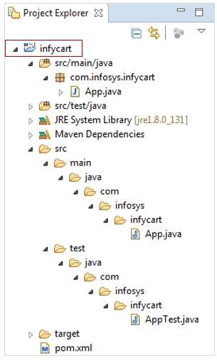
Standard Directory Structure of a Maven-based Java Project

Slide 16

Project Object Model(POM):
Project Object Model is the most important, logical unit of work in any Maven project.
It is basically an XML configuration file named pom.xml with the information about project and the necessary configurations.
It not only describes what to build, but, how to build as well.

Slide 17
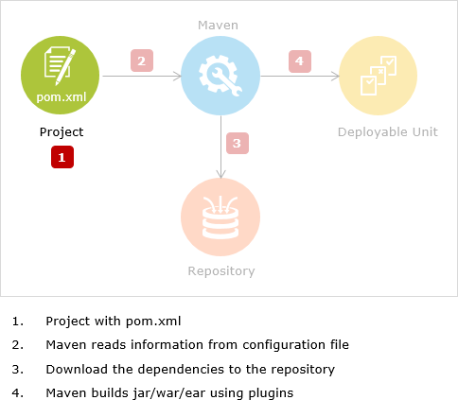
Project Object Model(POM):

Slide 18
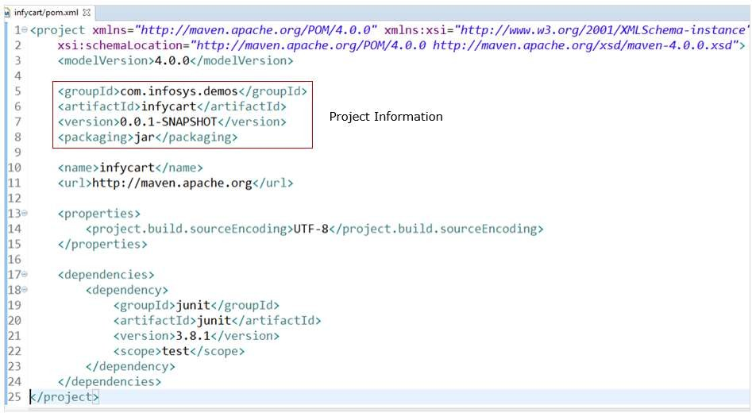
Project Object Model(POM):

Slide 19

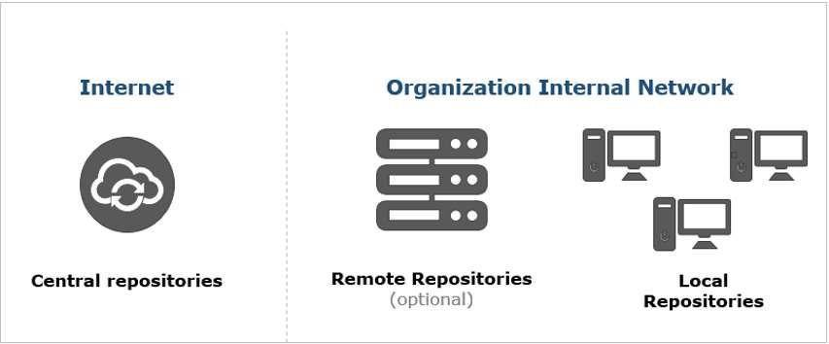
Repositories
Types of Repositories

Slide 20

Local Repository
Local repository refers
to the location/folder in the
developers machine where the copy of dependencies get downloaded and stored.
The local repository in a Windows machine is located in, C:\\users\<<USERNAME>>\.m2 with .m2 folder name as repository.

Slide 21

Central Repository
Central Repository is the public website/repository given by Maven. It has all the most commonly used libraries for project builds.
Central | repository | exists outside | the developer's
machine Internet | connection | is mandatory | to access Central
repository

Slide 22
Central Repository
Searching for an artifact in the Central Repository
Step 1 : Visit the Maven Repository site -
https://mvnrepository.com
Step 2 : Search for the required dependency by providing the dependency name in the Search field
Step 3 : Click on the version of the artifact that your project requires

Slide 23

Remote Repository
There could be a scenario wherein all the dependencies required for the project are not available in internal/org- wide repository or central repository.
Remote repository exists outside the organization. The organization is not involved in setting-up any external repository whereas ample of external repositories are available over Internet.

Slide 24
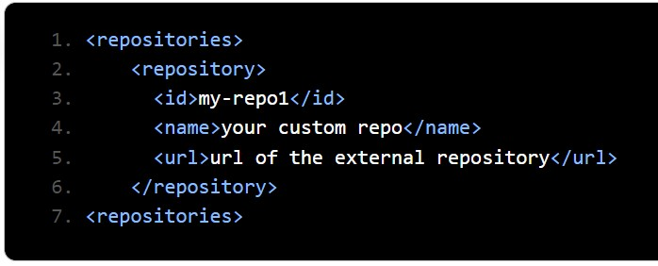
Remote Repository

Slide 25
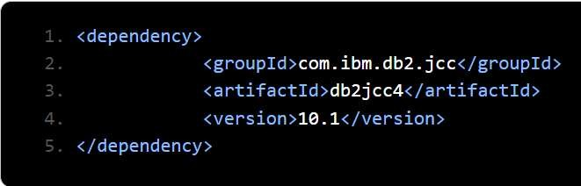
Remote Repository

Slide 26

Dependencies
In Maven, a dependency is just another archive—JAR, ZIP, and so on—which our current project needs in order to compile, build, test, and/or run. These project dependencies are collectively specified in the pom.xml file, inside <dependencies> tag.

Slide 27
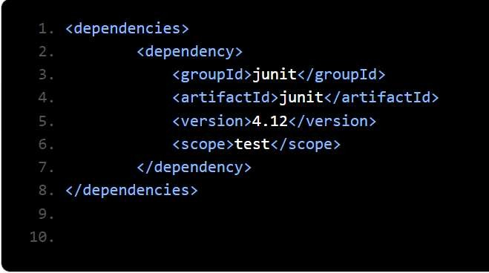
Dependencies

Slide 28
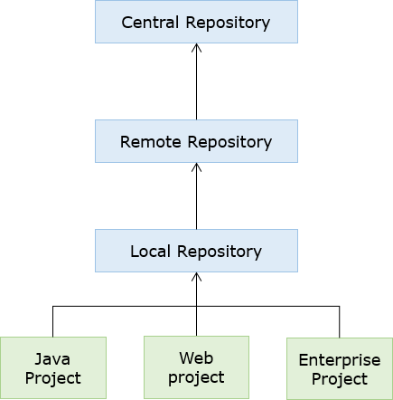
Dependencies

Slide 29

Maven Lifecycles and Phases
Three Maven Lifecycles in existence:
Default/Build Maven Lifecycle
Clean Maven Lifecycle
Site Maven Lifecycle

Slide 30
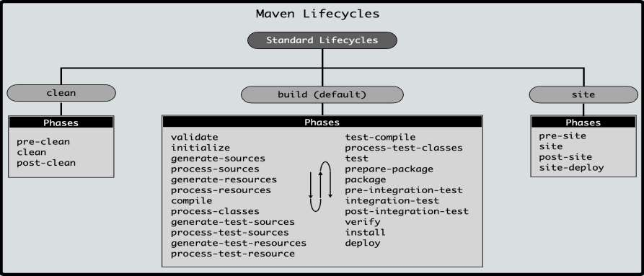
Maven Lifecycles and Phases

Slide 31

Maven Lifecycle and Phases
The Build/Default Maven lifecycle consists of 7 major phases as listed below:
validate
compile
test
package
verify
install
deploy

Slide 32
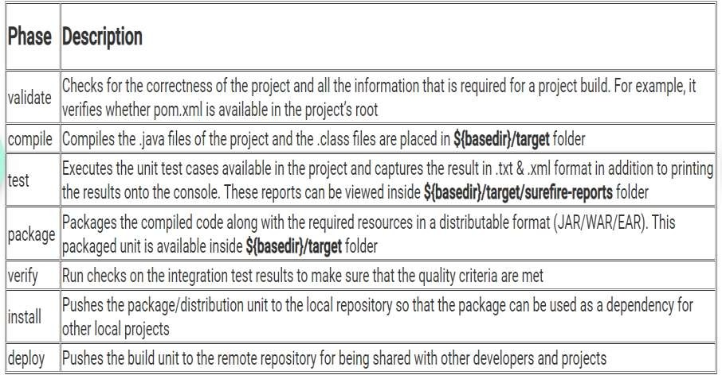
Maven Lifecycle and Phases

Slide 33

Maven Plug-ins and Goals
Maven is a plug-in-execution-based build tool.
These plug-ins play major roles in executing the various goals of projects.
All the required plug-ins needed for the basic build process are already associated with the build life-cycle phases.

Slide 34
Maven Plug-ins and Goals
Plug-ins can be broadly categorized into two types:
Build: Helps in executing the goals during build and are configured in <build /> element of pom.xml
Reporting: Helps in executing the goals for site generation and are configured in <reporting /> element of pom.xml

Slide 35
Maven Plug-ins and Goals
Every Maven plug-in can associate with several goals.
A goal is a logical, small, precise unit of work to be executed as single/with other goals during the build process.
Some of the available Maven plug-ins are as follows:
maven-compiler-plugin : has goals for compiling source code and unit tests
maven-surefire-plugin : has goals for execution of unit tests and publishing its reports

Slide 36
Maven Plug-ins and Goals
maven-jar-plugin : has goals for creating JAR files
maven-clean-plugin : has goal for the deletion of target folder

Slide 37
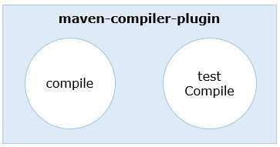
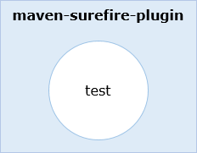
Maven Plug-ins and Goals

Slide 38
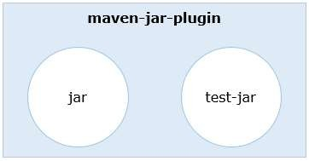
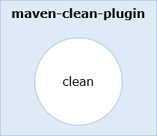
Maven Plug-ins and Goals

Slide 39

Home Task
Maven Certification at Infosys Springboard
Apache Maven (Level: Beginner)
Maven Tutorial - Manage Java Dependencies in 20 Steps (Level: Intermediate)
Learning Apache Maven 3 (Level: Advanced)

